Slide 1


2019
Shopping Everyday
Team：YanBingjie Jayce，WangNan Bonnie，TengChang Krystal，NiuCong Daniel
Assistance：Rupali、Abhijeet、Manmeet、Deliucia
Hainu University NIIT·ISAS

Slide 2
1 Special thanks
2 Use of technology
CONTENTS
3 Market demand analysis
4 Website details
5 Log data analysis

Slide 3
1
Special thanks
step 1

Slide 4
1
Special thanks
Thanks for all of you!
In the process of making difficult projects, we have received help from many people. Teachers Liu Decai, Rupali, Abhijeet, and all the students and relatives who have provided ideas, ideas, and help for our project have given us technology And provide great help emotionally.
We would like to express our sincere gratitude to everyone who helped us to overcome the difficulties and accompany us through this boring and fun day.
Notes:
4

Slide 5
2
Use of technology
step two

Slide 6


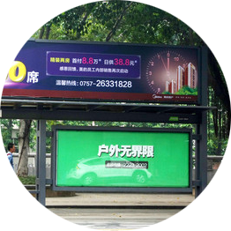


2
Use of technology
operating system
database
usage
Database connection driver
data analysis
server
Windows、Linux
Mysql、HBase
Apache Tomcat
Java web IDE
Hadoop MapReduce
JSP Compared with JavaScript: Although JavaScript can dynamically generate HTML on the client side, it is difficult to interact with the server, so it cannot provide complex services such as database access and image processing.
Compared with static HTML: Static HTML does not contain dynamic information.
Hadoop MapReduce is a software framework based on which you can easily write applications that can run on large clusters of thousands of business machines and process them in a reliable, fault-tolerant manner in parallel Massive datasets on the terabyte level. There are these keywords in this definition,
Notes:
6

Slide 7
3
Market demand analysis
step 3

Slide 8
3
Market demand analysis
Functional Requirements
Analyze our own logs
Analyze weblog requirements
The details of the first type of analysis is described below!
Notes:
8

Slide 9
3
Market demand analysis
User registration, login
View product categorie
Search for required products
Customers must first register as users of the online mall. You only need to fill in the login user name and password when registering. After registration, the user can continue to fill in the detailed information, and at the same time can change the password, query and modify the order.
When you look at the product categories, you can see two levels of classification, the first level is the audience classification, and the second level is the clothing category classification, so that users can easily find the products they want to buy.
When you use the search function, the server will search the keywords in the form in the database according to the vocabulary you entered, and arrange the search results in the order you want to display on the screen.
Notes:
9

Slide 10
3
Market demand analysis
Add to Shopping Cart
Buy commodity
Analyze data
After selecting the product, the customer can enter the shopping cart page to view the product they want to buy, modify the quantity of a certain product, cancel the purchase of a certain product, and empty the entire shopping cart.
The customer submits the order, displays the corresponding form and asks it to be filled in. The system records the consignee information submitted by the customer for his next purchase. The customer can check the order in the online mall, and can cancel, modify, etc. the order that has not been processed.
The website adds the order submitted by the customer to the database for storage, and generates a log file. We can collect information and analyze it at the big data level.
Notes:
10

Slide 11
4
Website details
step 4

Slide 12
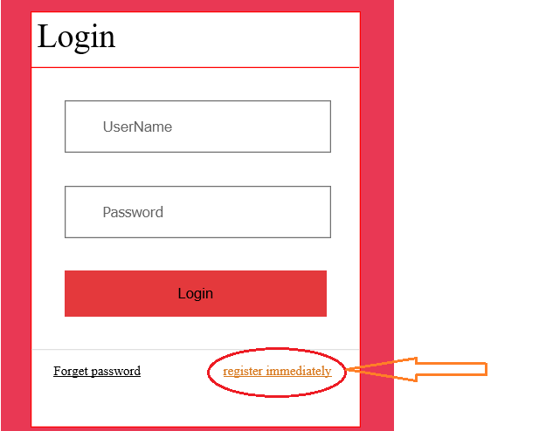
4
Website details
Notes:
12

Slide 13
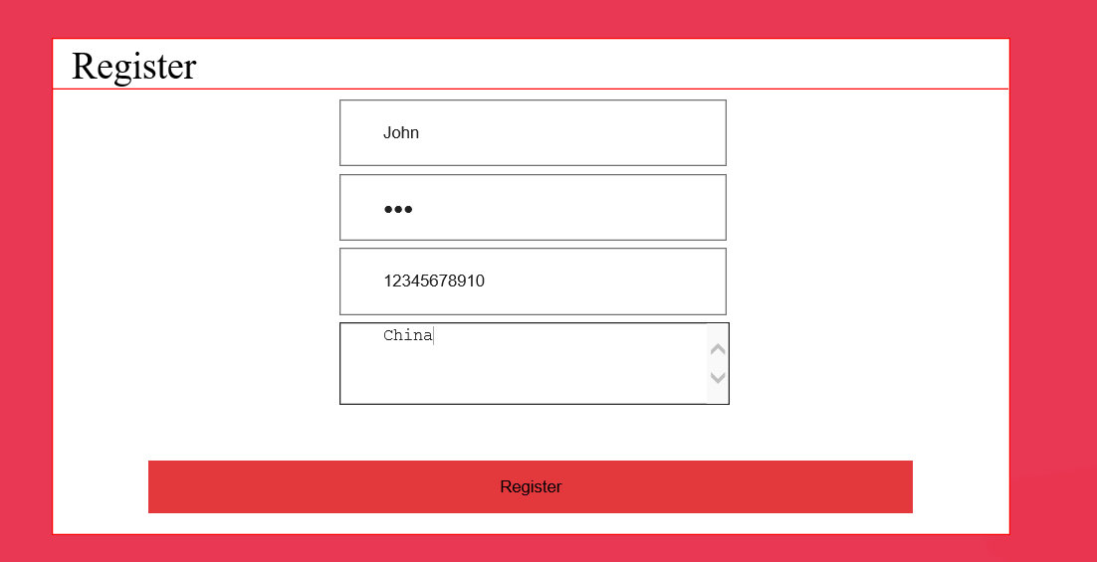
4
Website details
Notes:
13

Slide 14
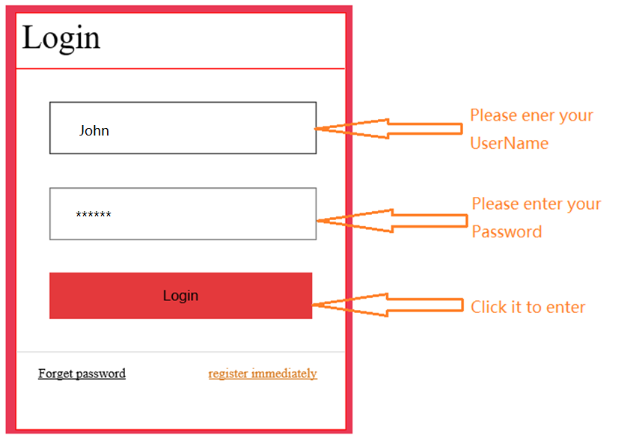
4
Website details
Notes:
14

Slide 15
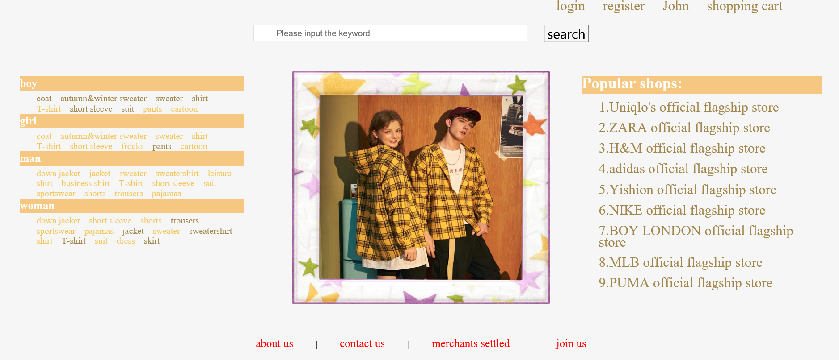
4
Website details
Notes:
15

Slide 16
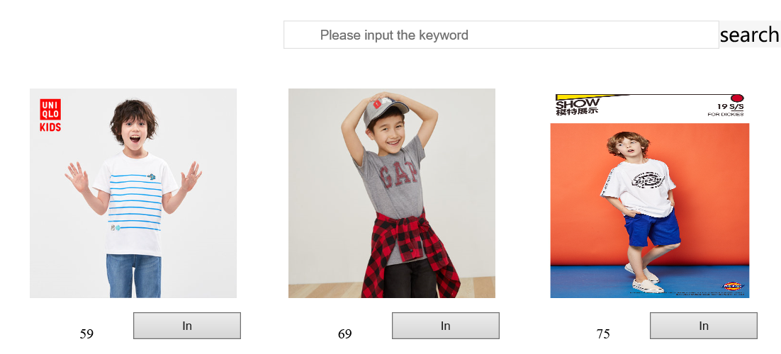
4
Website details
Notes:
16

Slide 17
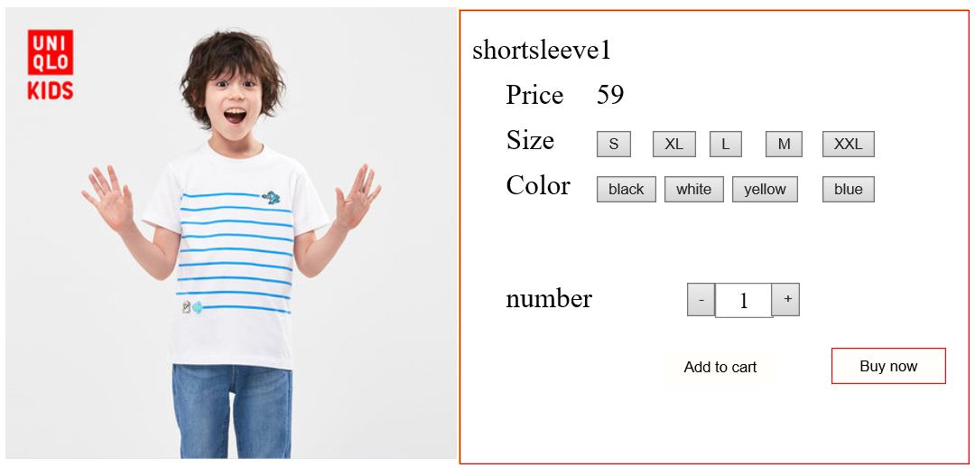
4
Website details
Notes:
17

Slide 18
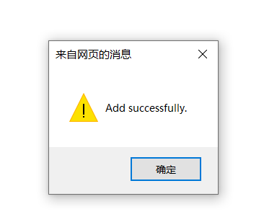
4
Website details
Notes:
18

Slide 19
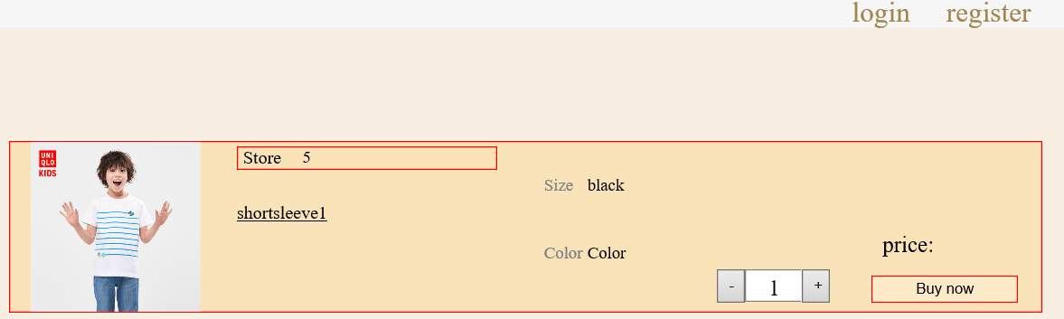
4
Website details
Notes:
19

Slide 20
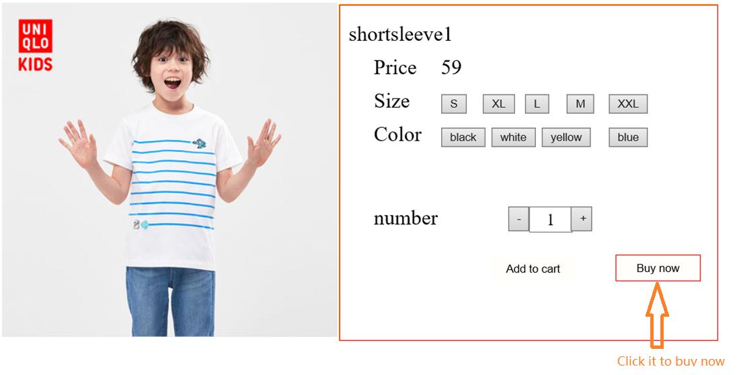
4
Website details
Notes:
20

Slide 21
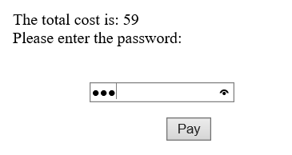
4
Website details
Notes:
21

Slide 22
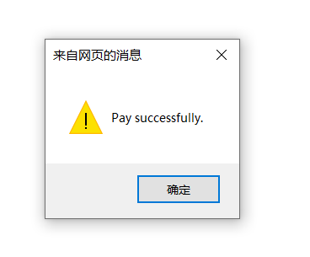
4
Website details
Notes:
22

Slide 23
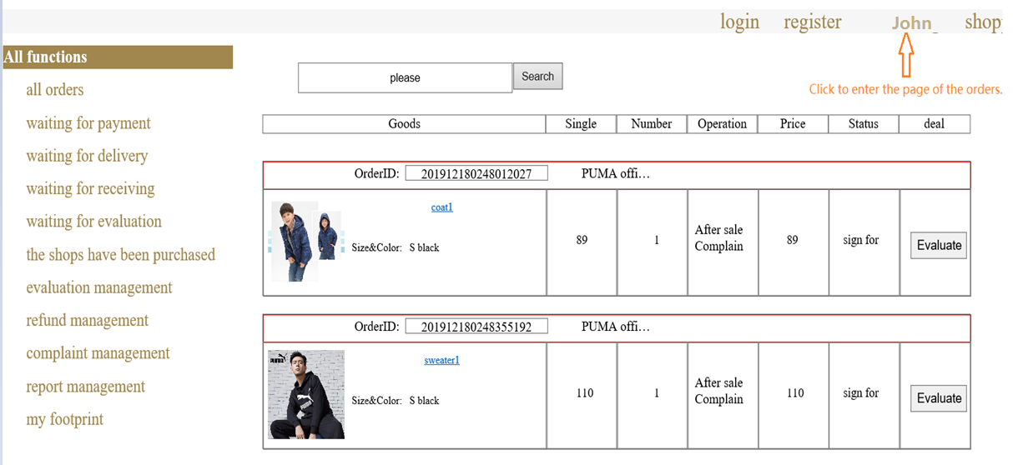
4
Website details
Notes:
23

Slide 24
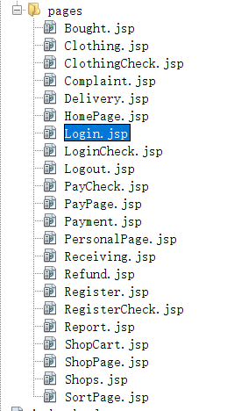
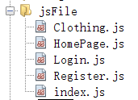

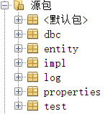
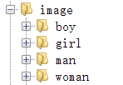
4
Website details
Notes:
24

Slide 25
5
Log data analysis
step 5

Slide 26
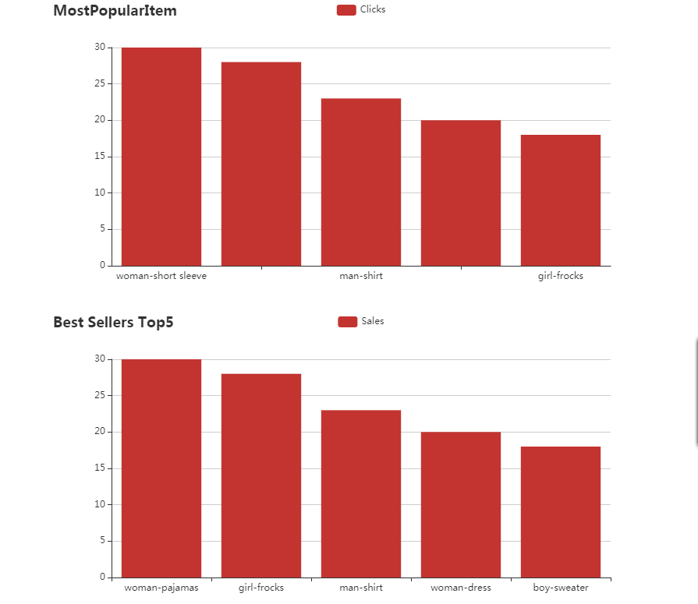
5
Log data analysis
Most popular item：
Best sellers：
点击添加文本,点击添加文本 ,点击添加文本,点击添加文本 ,点击添加文本,点击添加
Notes:
26

Slide 27
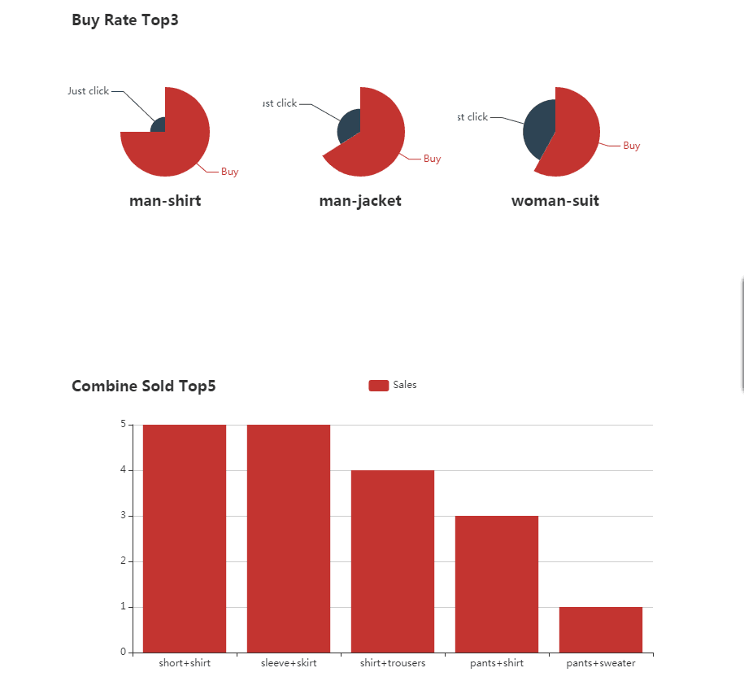
5
Log data analysis
Buy rate：
Combine sold：

